Slide 1
Thesis
Thesis 9 October 2026
Investment research you can revisit
Bryant & Jia Hui
Notes:
Thesis is a local investment research MVP for students and newer investors. The team names are Bryant and Jia Hui, as supplied by the team. The current product is not a publicly hosted service.
Sources: /Users/jiahuiwong/Documents/GitHub/Thesis/README.md

Slide 2
The Thesis pitch
The research problem
Why an investment idea needs evidence and a way to revisit it
The product
A working workspace for company research and saved reasoning
The opportunity
A campus pilot and a proposed subscription model
The next stage
Validate repeat use, research quality and willingness to pay
Thesis 9 October 2026
Notes:
This pitch describes the current prototype and the proposed path to a student pilot. Commercial assumptions remain unvalidated.

Slide 3
Help new investors understand
what they believe, why they believe it,
and when the evidence changes
A research workspace built around the investor’s own reasoning
Thesis 9 October 2026
Notes:
The recurring job is to investigate an idea, identify evidence that could challenge it, and review changes. This is the product vision, not a claim of measured investment performance.
Sources: /Users/jiahuiwong/Documents/GitHub/Thesis/docs/archive/planning/product-and-launch-plan.md

Slide 4
The problem: keeping a reasoned view
Information lives in separate places
Filings, financial charts, headlines and discussions need context.
A convincing story still needs checking
New investors need to distinguish reported facts from expectations.
The original reasoning is easy to lose
A saved note rarely explains what later evidence means for the idea.
Our hypothesis
Research tied to an explicit thesis can make review more useful.
Thesis 9 October 2026
Notes:
The pain points are product hypotheses from the team’s launch plan. No completed customer study, measured time saving or validated problem frequency is claimed. The proposed interviews will test the current alternatives people use and what makes research difficult.
Sources: /Users/jiahuiwong/Documents/GitHub/Thesis/docs/archive/planning/product-and-launch-plan.md

Slide 5
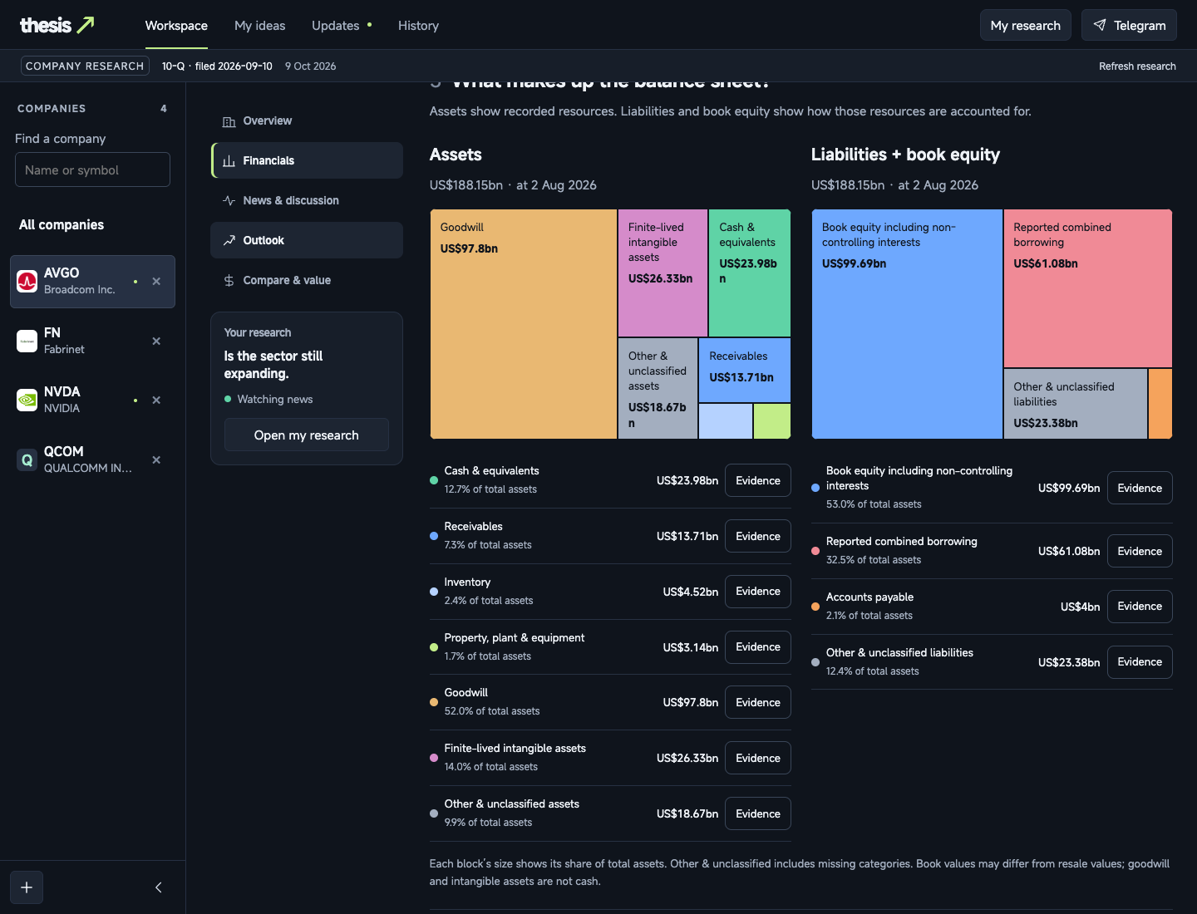
The solution: one research workspace
Working local prototype
Understand the company
Read financials and expectations
with dates and original evidence.
Save the reasoning
Keep a question, a view and the
conditions that would challenge it.
Review what changes
Inspect updates against the idea
you actually saved.
Thesis 9 October 2026
Notes:
Company research, original evidence, saved ideas, monitoring and Updates are implemented in the local MVP. Coverage and interpretation quality still have gaps. Screenshot: actual saved Broadcom financial position, captured on 9 October 2026. This product screenshot is not new investment guidance.
Sources: /Users/jiahuiwong/Documents/GitHub/Thesis/README.md
/Users/jiahuiwong/Documents/GitHub/Thesis/docs/reviews/2026-10-09/financials-redesign.md
/Users/jiahuiwong/Documents/GitHub/Thesis/.local/live-tests/financials-redesign-20261009/actual-balance-1440.png

Slide 6
Team
B
JH
Bryant
Jia Hui
Thesis 9 October 2026
Notes:
Team: Bryant and Jia Hui. Roles are intentionally blank at the team’s request. No qualifications, prior employers or advisor affiliations have been supplied.

Slide 7
Support we’re seeking
Research
Data
Pilot
Investment research
Review explanations and
challenging evidence
Data & product access
Help assess permitted
sources and launch needs
Campus introductions
Reach students beyond
our own social circle
Seeking input and introductions. No advisors or partnerships confirmed.
Thesis 9 October 2026
Notes:
These are proposed support needs for the pilot, not appointed advisors or signed partnerships. No outreach has been carried out as part of this presentation.
Sources: /Users/jiahuiwong/Documents/GitHub/Thesis/docs/archive/planning/product-and-launch-plan.md
/Users/jiahuiwong/Documents/GitHub/Thesis/README.md

Slide 8
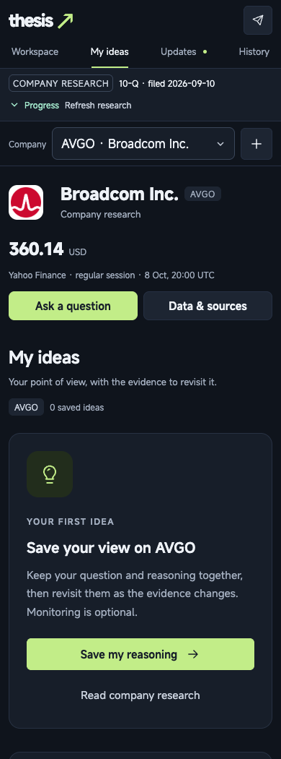
How Thesis works
01 Choose a company
Explore the business, financials and available expectations.
02 Investigate a question
Read sources and inspect the evidence behind an answer.
03 Save a thesis
Write the reasoning and approve any monitoring conditions.
04 Return to the evidence
Review relevant updates and decide whether to revise the view.
Thesis 9 October 2026
Notes:
Monitoring starts only when a user explicitly enables it. Saving reasoning and approving conditions are separate from watch activation. The screenshot shows the actual empty My ideas state for Broadcom and the original Save my reasoning action.
Sources: /Users/jiahuiwong/Documents/GitHub/Thesis/README.md
/Users/jiahuiwong/Documents/GitHub/Thesis/docs/features/reading-journey.md
/Users/jiahuiwong/Documents/GitHub/Thesis/.local/live-tests/ideas-ui-20261009/actual-ideas-390.png

Slide 9
Market entry: campus investors
Initial campus: NUS
31,086 undergraduates in AY2025/26.
This is an audience base, not paying demand.
31,086
First user segment
Students already researching individual
companies and looking for a repeat workflow.
Researching
shares
Proposed pilot
20–30 participants over four weeks.
Expansion depends on observed repeat use.
20–30
NUS Registrar, 7 Sep 2025. Circles are schematic, not to scale. Revenue market size remains unvalidated.
Thesis 9 October 2026
Notes:
Source: NUS Office of the University Registrar, Summary of Undergraduate Student Enrolment 2025/2026, as at 7 September 2025, page 1. Grand total 31,086, including full-time, part-time and flexible workload courses. https://www.nus.edu.sg/registrar/docs/default-source/student-statistics/enrolment-statistics/undergraduate-studies/ug-enrol-20252026.pdf
The headcount is a campus audience base, not a TAM, count of investors, prospective subscribers or reachable users. The research segment is a hypothesis, and its size is unknown. The proposed 20–30 participant four-week pilot comes from the team’s product and launch plan. Source: /Users/jiahuiwong/Documents/GitHub/Thesis/docs/archive/planning/product-and-launch-plan.md
Fresh graduates and other campuses are possible later segments, subject to validation.

Slide 10
Business model: recurring research
Free or trial access
Let a new user research a company and save a useful first thesis.
Proposed paid subscription
Offer greater research capacity, more active ideas and configurable monitoring.
A reason to continue
Preserve the reasoning and evidence history as the investor returns.
Pricing decision
Test willingness to pay against measured data, model and support costs.
Proposed model. No price, billing system or paid conversion confirmed.
Thesis 9 October 2026
Notes:
The launch plan proposes subscriptions for continuing research and monitoring rather than referral commissions or a course curriculum. Exact prices, quotas and refresh intervals remain unresolved. Basic provenance and honest uncertainty should remain available at every tier. Billing remains unfinished.
Sources: /Users/jiahuiwong/Documents/GitHub/Thesis/docs/archive/planning/product-and-launch-plan.md
/Users/jiahuiwong/Documents/GitHub/Thesis/README.md

Slide 11
Working MVP, customer validation next
Built in the local prototype
What the pilot will measure
Company research with original evidence
Saved reasoning and revision history
Optional monitoring and review updates
Activation: a researched, saved idea
Week-four research activity
Useful versus irrelevant alerts
Paid continuation in a later trial
No customer traction or paid conversion data confirmed. Research quality still needs evaluation.
Thesis 9 October 2026
Notes:
Technical implementation is not customer traction. Proposed activation is a brief review and approved thesis with at least one condition. Week-four retention uses meaningful research actions in days 22–28 among activated participants with a full 28-day observation window. Logins and automated deliveries alone do not count. Recruit beyond friends and report that segment separately. No validated retention, revenue, signup or paid-conversion metric is claimed.
Sources: /Users/jiahuiwong/Documents/GitHub/Thesis/README.md
/Users/jiahuiwong/Documents/GitHub/Thesis/docs/archive/planning/product-and-launch-plan.md

Slide 12
Competition & positioning
Alternative | Established focus | Thesis focus
Simply Wall St | Visual company reports, portfolio tools and alerts | Private reasoning linked to conditions and evidence
TradingView | Charts, market analysis and configurable alerts | A guided company research and review workflow
Notes & spreadsheets | A flexible way to record a personal investment view | Saved evidence and updates alongside the original idea
Our proposed advantage is continuity around a personal thesis.
We still need users to show that this makes research more useful.
Thesis 9 October 2026
Notes:
Competitor descriptions are based on their official product pages, accessed 9 October 2026. Simply Wall St offers visual fundamental research, portfolios, updates and community narratives: https://simplywall.st/ and https://support.simplywall.st/hc/en-us/articles/7246565363471-How-to-Monitor-Your-Stocks-and-Discover-New-Investing-Ideas
TradingView offers charts and alerts, including fundamental metric alerts: https://www.tradingview.com/features/ and https://www.tradingview.com/support/solutions/43000786831-alerts-on-fundamentals/
The Thesis column describes the intended emphasis of this MVP, not an audited feature absence in competitors or proof of superiority. Notes and spreadsheets are a workflow alternative. The proposed advantage and repeat-user benefit remain to be validated. Internal source: /Users/jiahuiwong/Documents/GitHub/Thesis/README.md

Slide 13
Go to market: a focused campus pilot
Recruit around a real research task
Demonstrate one company idea through campus networks and investing clubs.
Run a proposed four-week cohort
Invite 20–30 students, including people who do not know the team.
Observe the full research loop
Track source comprehension, saved ideas, return visits and useful updates.
Expand only after repeat value
Improve the workflow, then test a defined paid offer and referrals.
Thesis 9 October 2026
Notes:
This is a proposed acquisition and validation plan. No club partnership, cohort signup, acquisition cost, referral result or paid trial has been confirmed. The existing plan suggests interviewing roughly ten participants at the end. A small four-week cohort provides early evidence, not proof of long-term retention.
Sources: /Users/jiahuiwong/Documents/GitHub/Thesis/docs/archive/planning/product-and-launch-plan.md

Slide 14
Roadmap: evidence before expansion
A proposed sequence after pilot preparation.
Later stages depend on user results and launch readiness.
Now
Local MVP
Pilot
Four weeks
Later
Hosted beta
Next
Quality review
Then
Paid trial
If validated
Campus growth
Thesis 9 October 2026
Notes:
Only the local MVP is current. The remaining milestones are a proposed sequence, not committed dates. Preparation should assess source coverage and research/alert interpretation. A hosted beta requires portable AI setup, deployment/security work and ongoing operating readiness. Paid trials require a defined offer and measured cost to serve.
Sources: /Users/jiahuiwong/Documents/GitHub/Thesis/README.md
/Users/jiahuiwong/Documents/GitHub/Thesis/docs/archive/planning/product-and-launch-plan.md

Slide 15
Financials: revenue sensitivity
Illustrative monthly subscription revenue in SGD
Paying users | S$5 / month | S$10 / month | S$15 / month
100 | S$500 | S$1,000 | S$1,500
500 | S$2,500 | S$5,000 | S$7,500
1,000 | S$5,000 | S$10,000 | S$15,000
Revenue = paying users × monthly price
Scenarios only. Price and user counts are assumptions, not forecasts.
Gross revenue excludes data, AI, hosting, payments and support costs.
Thesis 9 October 2026
Notes:
All values on this slide are illustrative arithmetic scenarios introduced for discussion. The team has not confirmed pricing, subscribers or revenue. Monthly recurring gross revenue is user count multiplied by the assumed monthly subscription price. The values are not forecasts and do not imply gross margin, operating profit, runway or a valuation. Costs and willingness to pay must be measured before setting an offer. All amounts on this slide use Singapore dollars.

Slide 16
The ask: pilot access and feedback
Immediate support
Introductions to student investors and campus investing communities.
Expert feedback
Review whether explanations, evidence and alerts support sound research.
Next funding decision
Set any raise amount after the pilot, data-access plan and operating budget.
What funding would support
Reliable sources, product quality and a supported hosted beta.
No funding round, amount raised or runway confirmed.
Thesis 9 October 2026
Notes:
The immediate request is proposed pilot access and expert feedback. No funding amount, completed raise, cash balance, hiring commitment or runway was supplied. Any eventual financial ask should follow a costed plan informed by pilot evidence.
Sources: /Users/jiahuiwong/Documents/GitHub/Thesis/docs/archive/planning/product-and-launch-plan.md
/Users/jiahuiwong/Documents/GitHub/Thesis/README.md

Slide 17
Thesis
A clearer record of why you invest
Bryant & Jia Hui
Pilot introductions and feedback welcome
Thesis 9 October 2026
Notes:
The next step is a proposed student pilot to test whether Thesis supports useful research and repeated evidence review. Team: Bryant and Jia Hui. No public website or contact email has been supplied.

